Slide 1
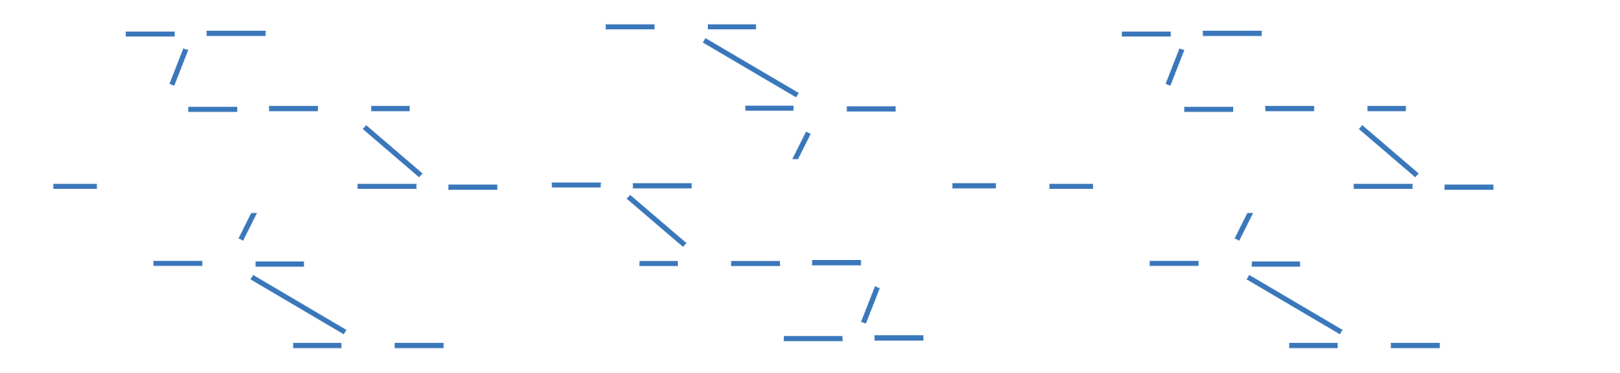
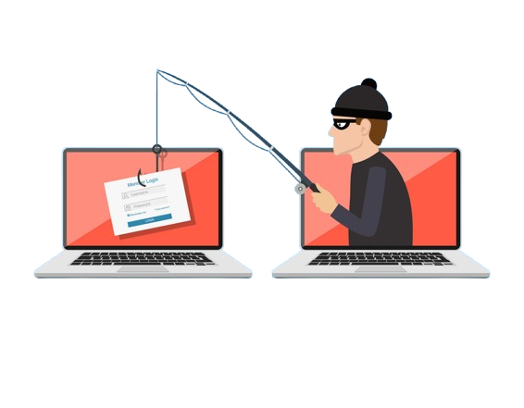
CAUTION!
Phishing Attacks: A threat to your digital security

Slide 2

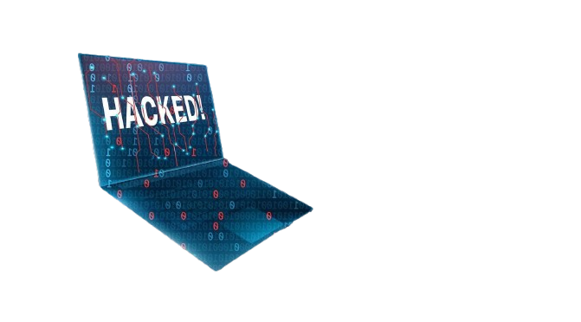

Contents
What is Phishing?
01
Types of Phishing attacks?
02
How to prevent Phishing attacks?
03

Slide 3
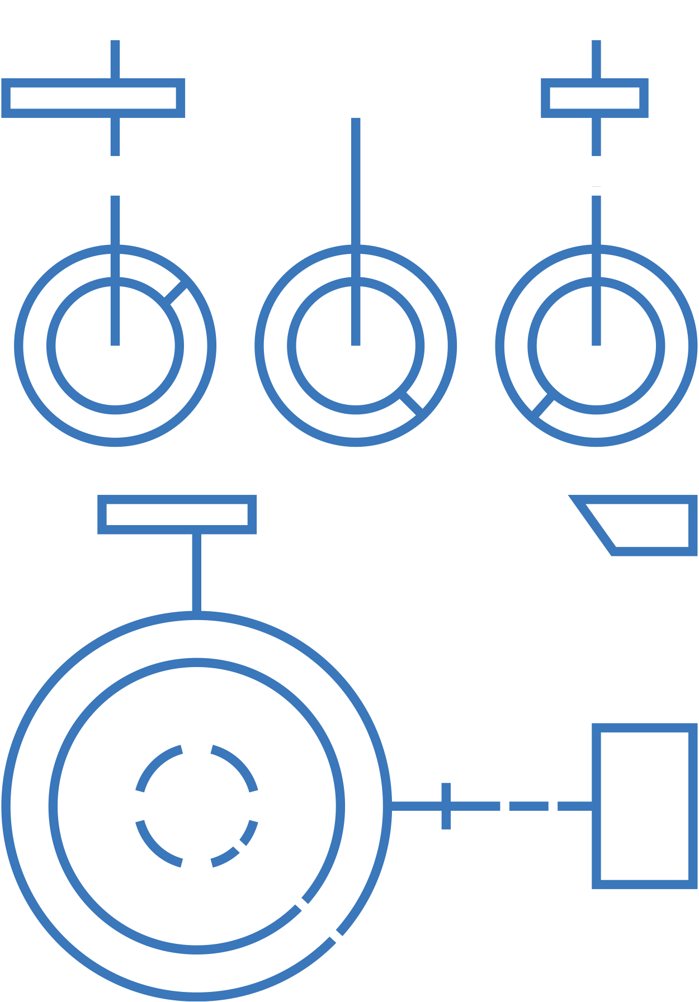

What is Phishing?
Phishing is the use of digital communications to trick people into revealing their sensitive data or injecting viruses into their systems. Phishing not only affects individuals but also it have the ability to cause harm to an organization’s security. There are different types of phishing attacks, we will be discussing some common ones .

Slide 4

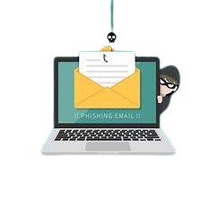
Email Phishing
The email phishing is the most common type of phishing attack. As the name suggests the attacker sends an email to the target in order to attain private information. For example an attacker can impersonate as someone who works at the bank and asks you to provide your back account id to view the bank statement. The attacker can also attach a malicious link with the email to generate virus in your system, letting him take control over it.

Slide 5

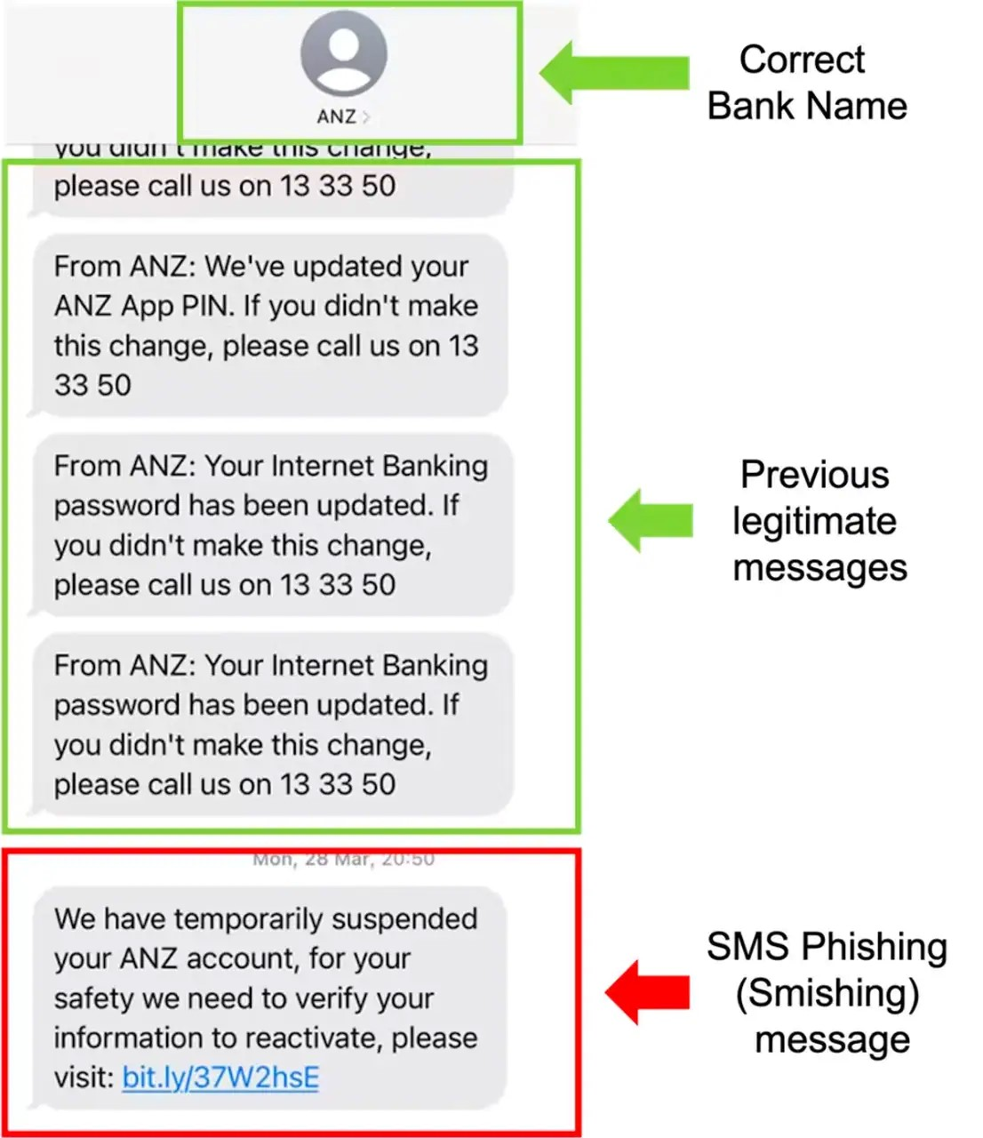
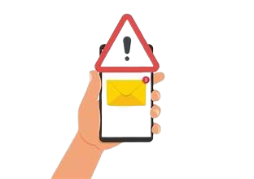

Smishing
Smishing is a type of phishing attack in the an attacker uses Short Message Service (SMS), a technology that powers text message. An example of this can be an attacker impersonating a mobile phone sim company offering the user unlimited minutes for a week by filling a form which demands your private info.

Slide 6
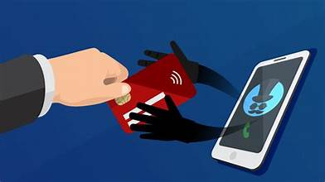
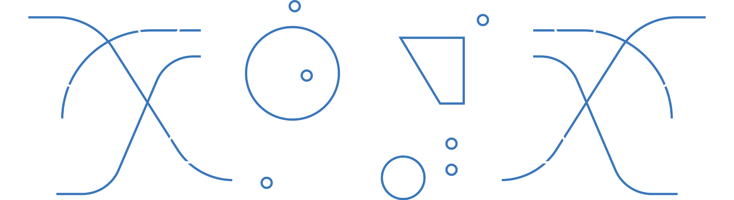
Vishing
Vishing refers to the use of voice calls or voice messages to trick targets into providing personal in formation over the phone. You receive a call from someone claiming to be from a government service, like your local tax office or social security department. The caller says,"Hi, this is Mark from the Tax Authority. We noticed a discrepancy in your tax filings and there’s a pending legal matter. We need to verify your personal details right away to avoid penalties or further action. Can you please confirm your social security number?"The urgency in their voice makes you feel like you need to act quickly, so you consider providing the information.

Slide 7
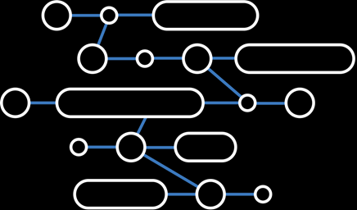
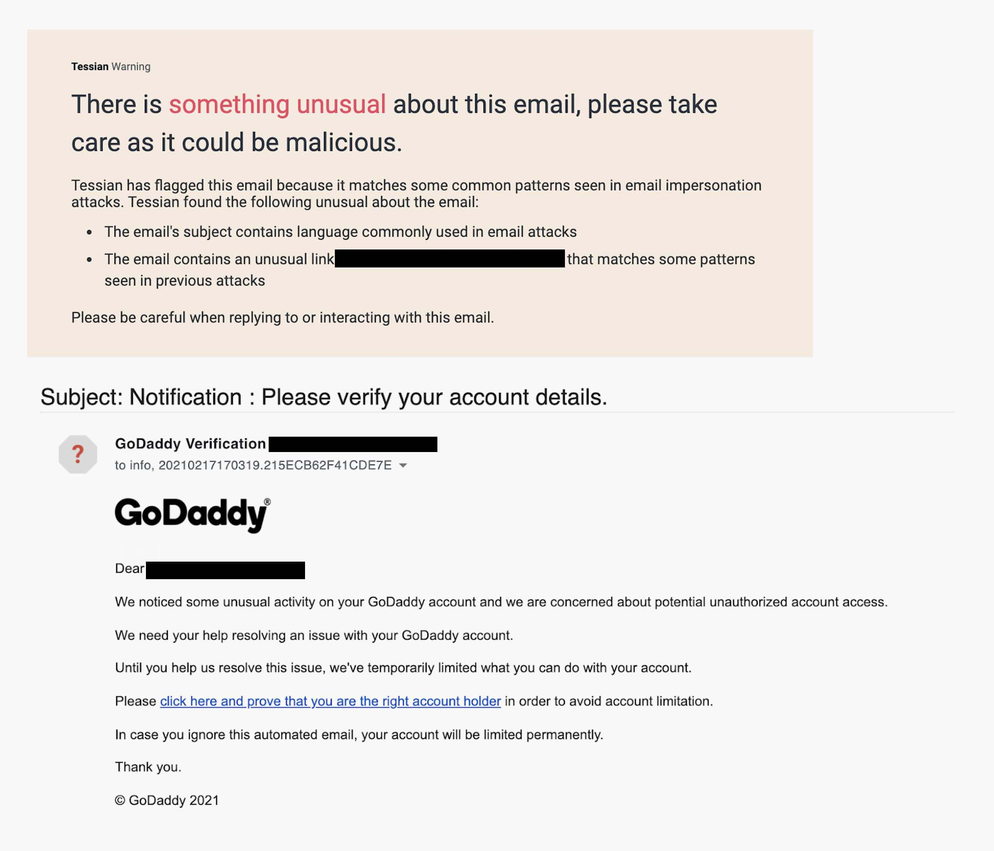

Spear Vishing
Spear phishing is basically a subset of email phishing in which specific people are purposefully targeted, such as the accountants of a small business to steal sensitive business information. Unlike generic phishing attempts that target a broad audience, spear phishing is highly personalized, often using information about the target to increase the likelihood of success.

Slide 8
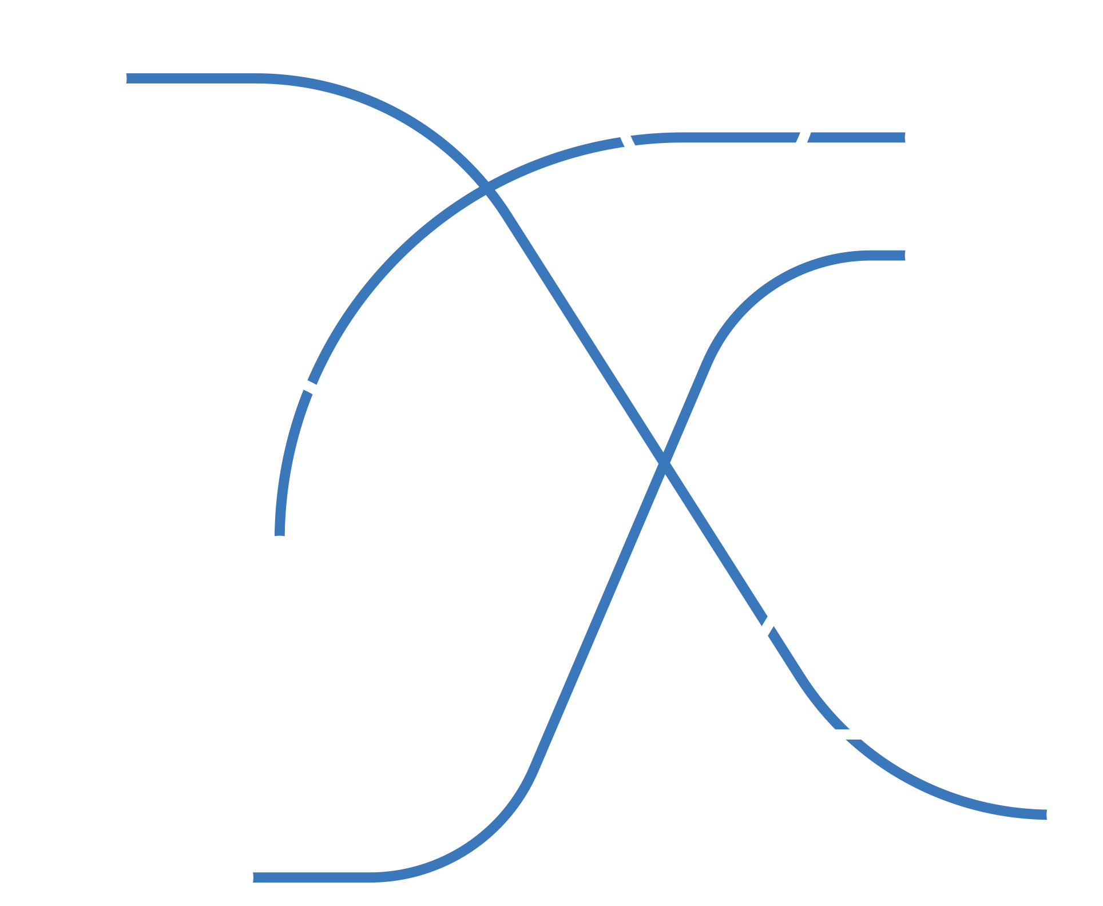
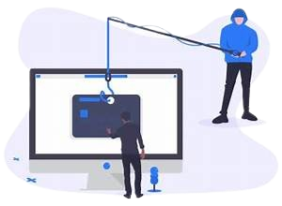
Whaling
Whaling refers to a category of spear phishing attempts that are aimed at high ranking executives in an organization. A whaling attack could impersonate the CEO’s legal counsel, asking them to urgently sign off on a payment for "closing the deal." Messages are crafted to appear like they come from trusted partners, legal advisors, or government agencies.

Slide 9
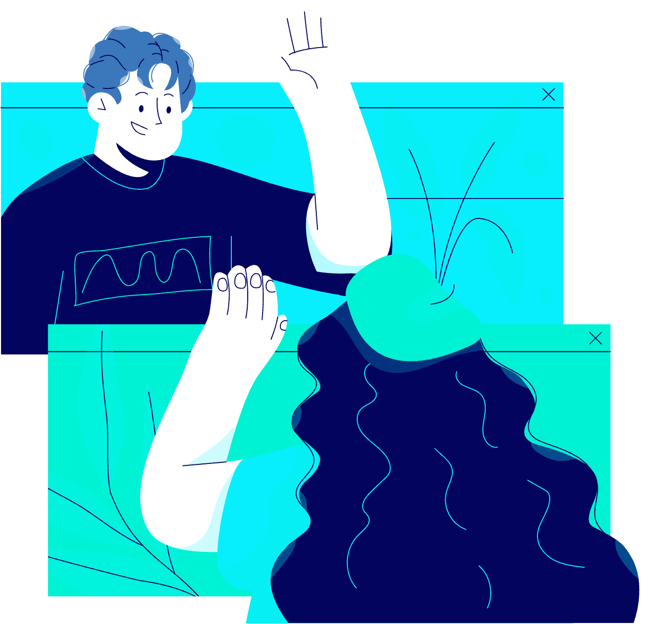





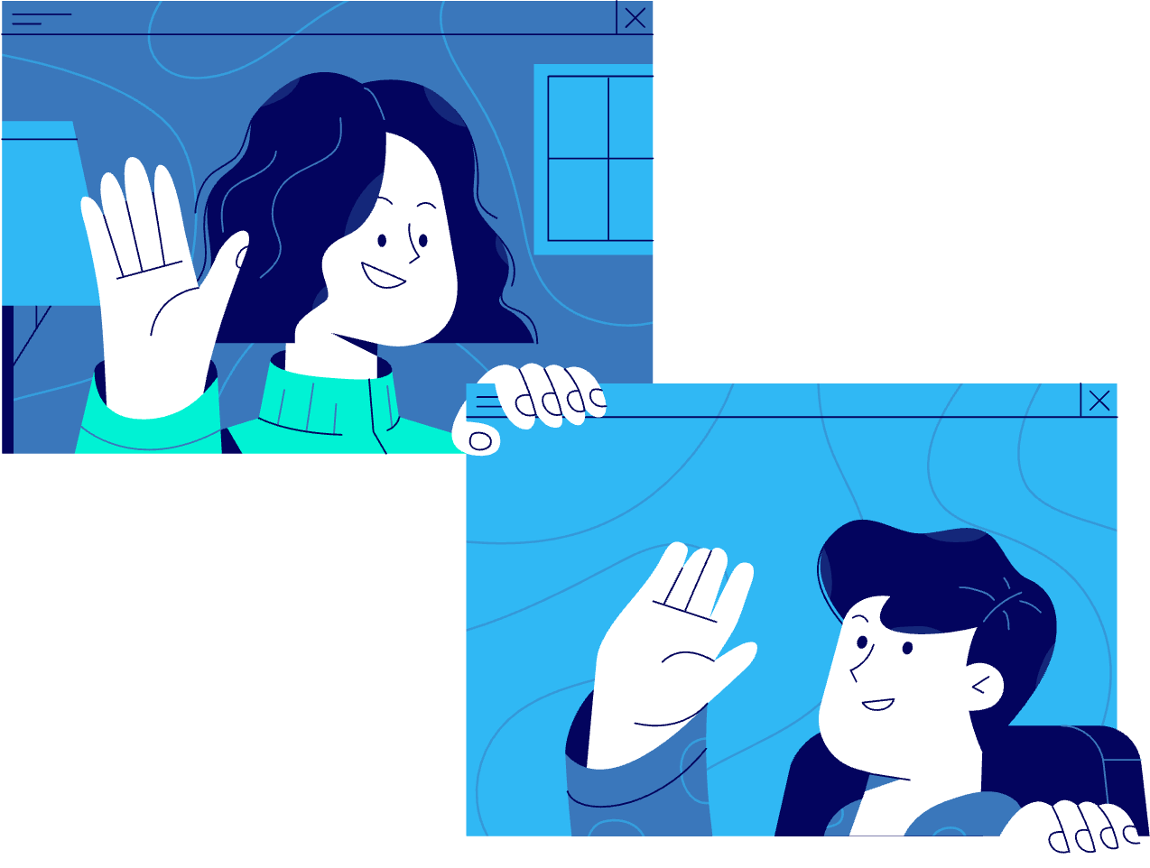
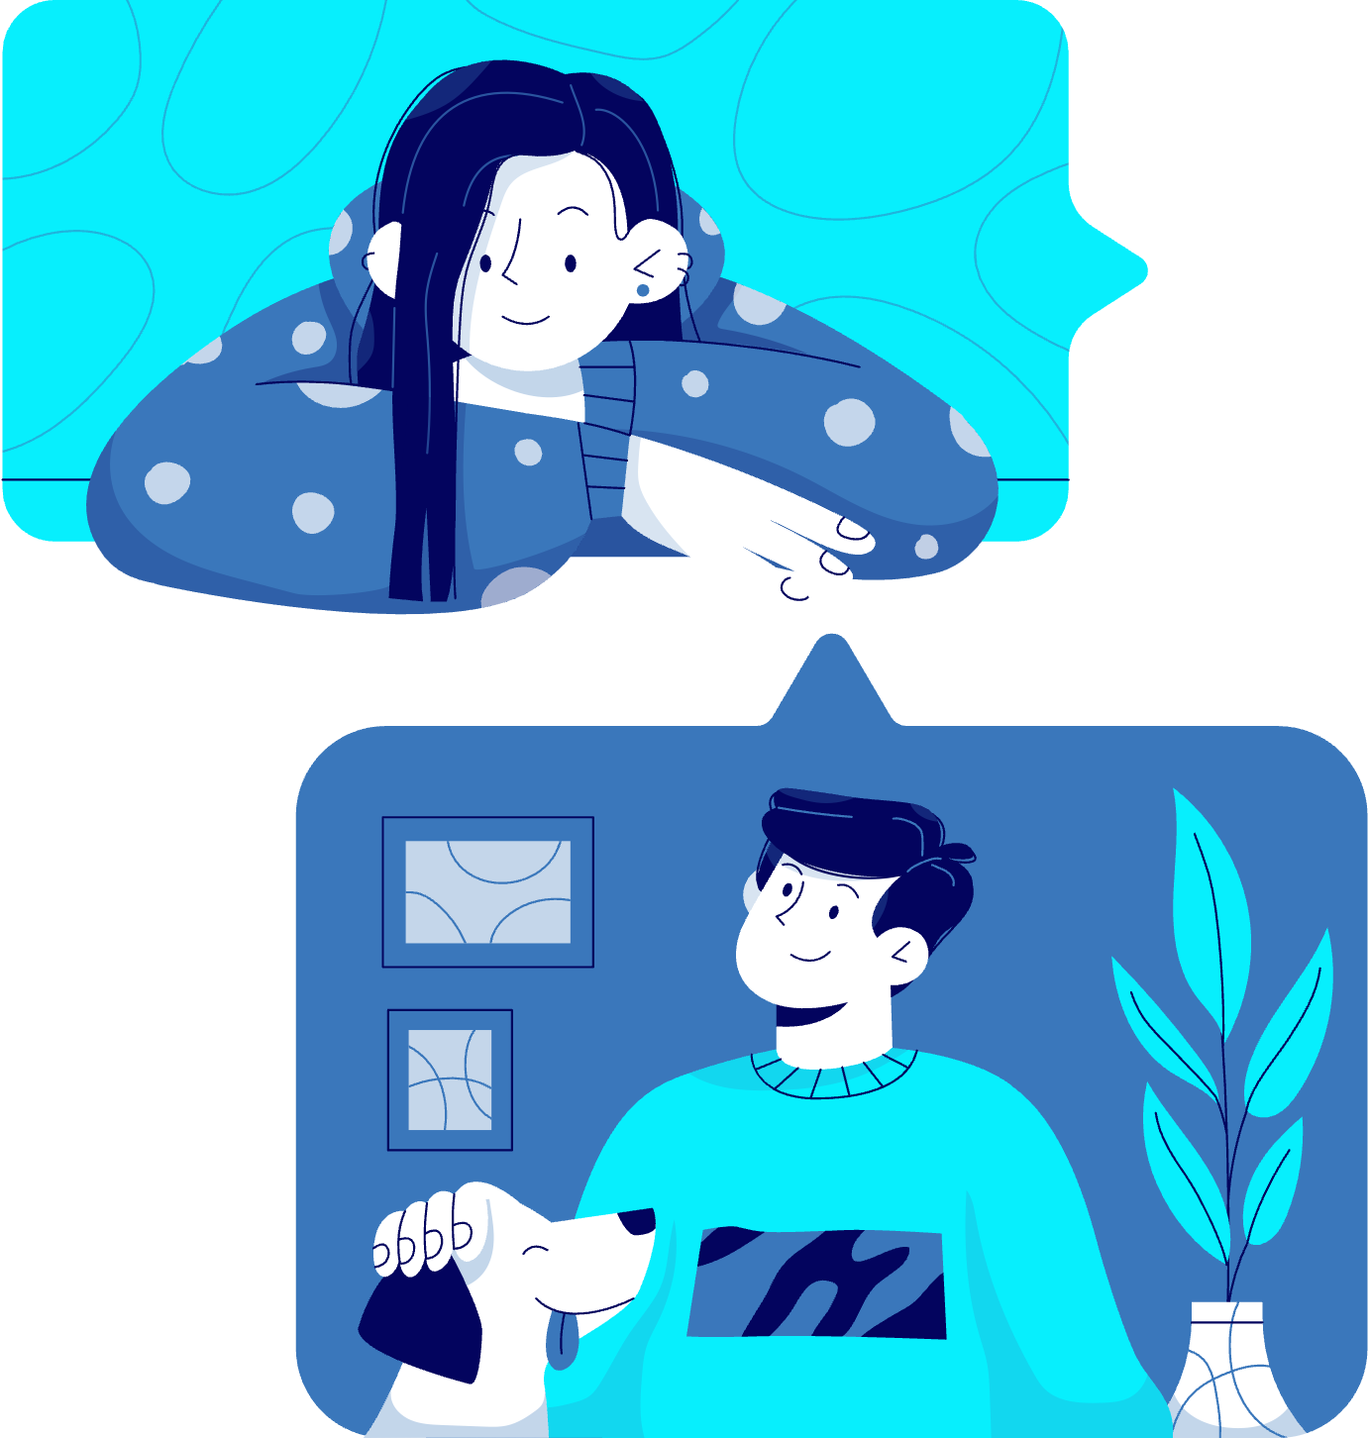



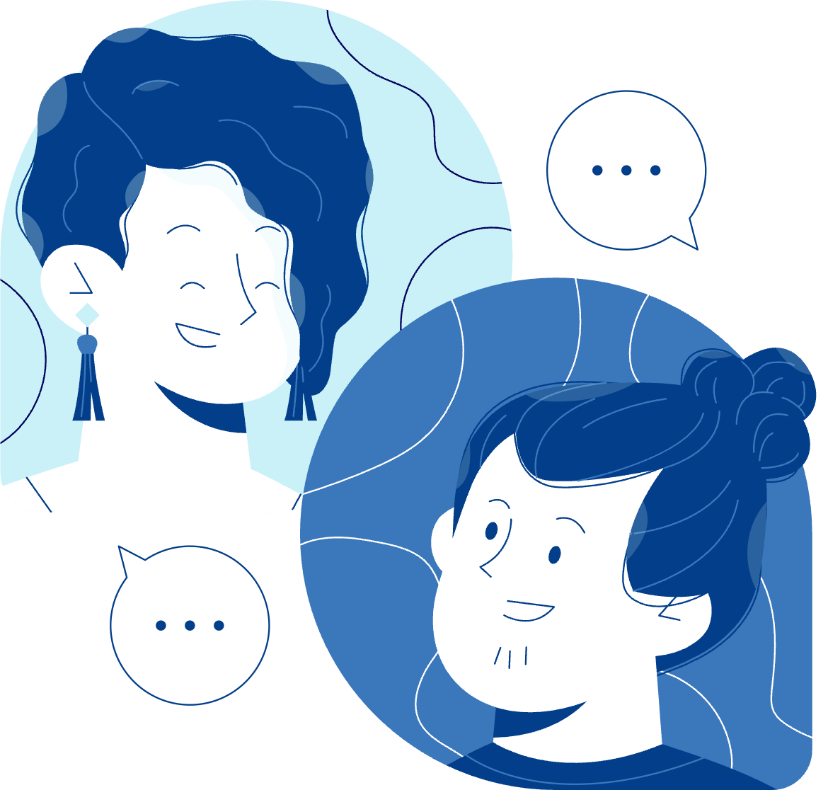






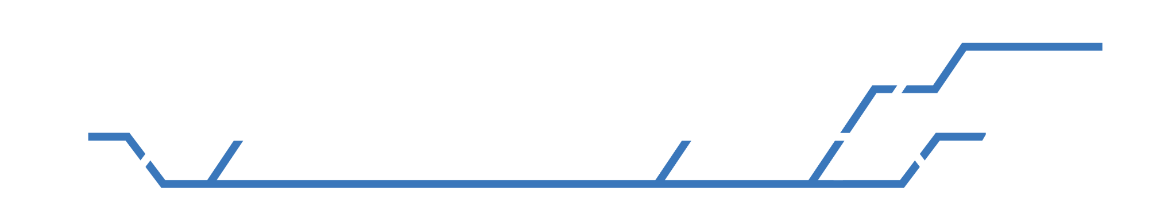
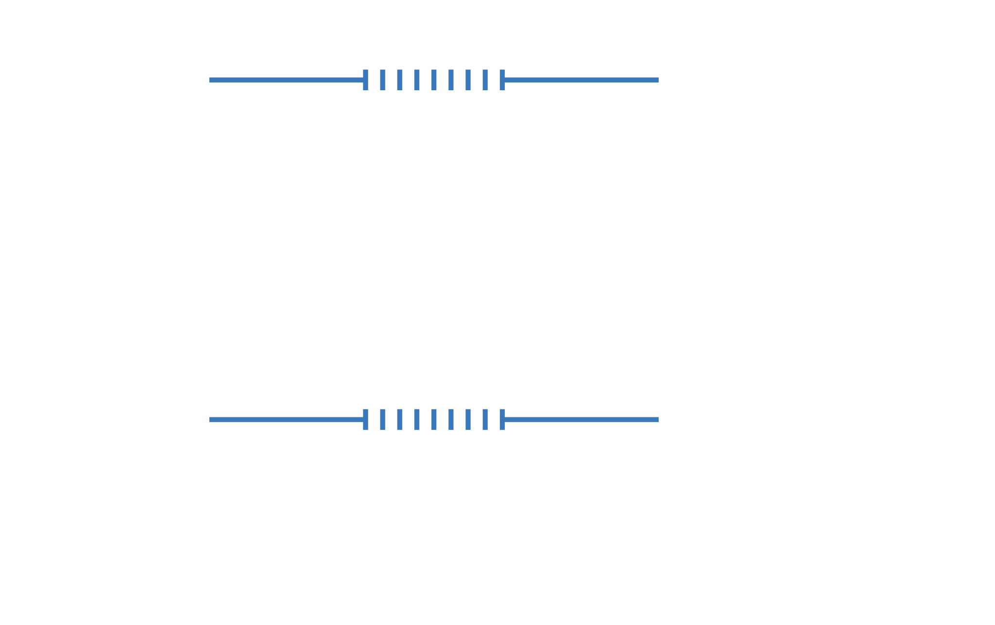
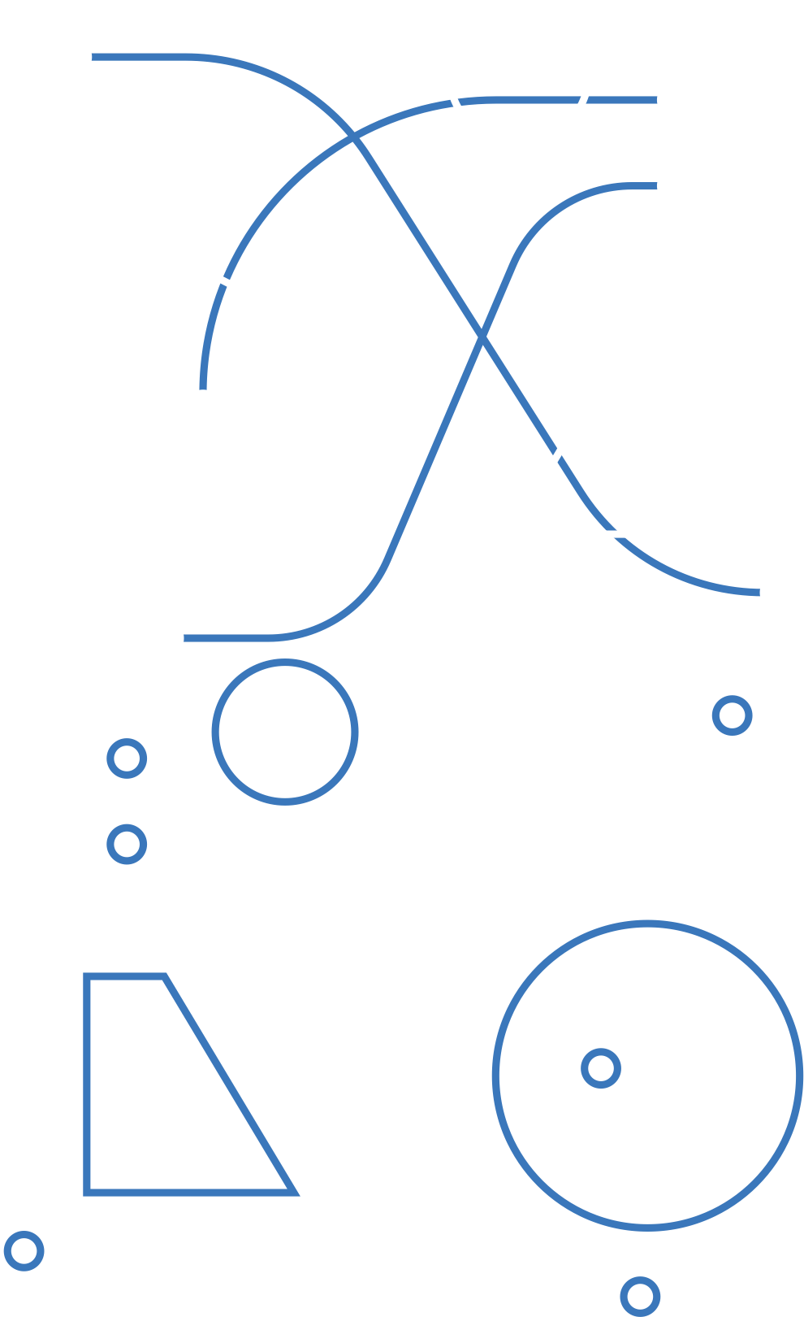





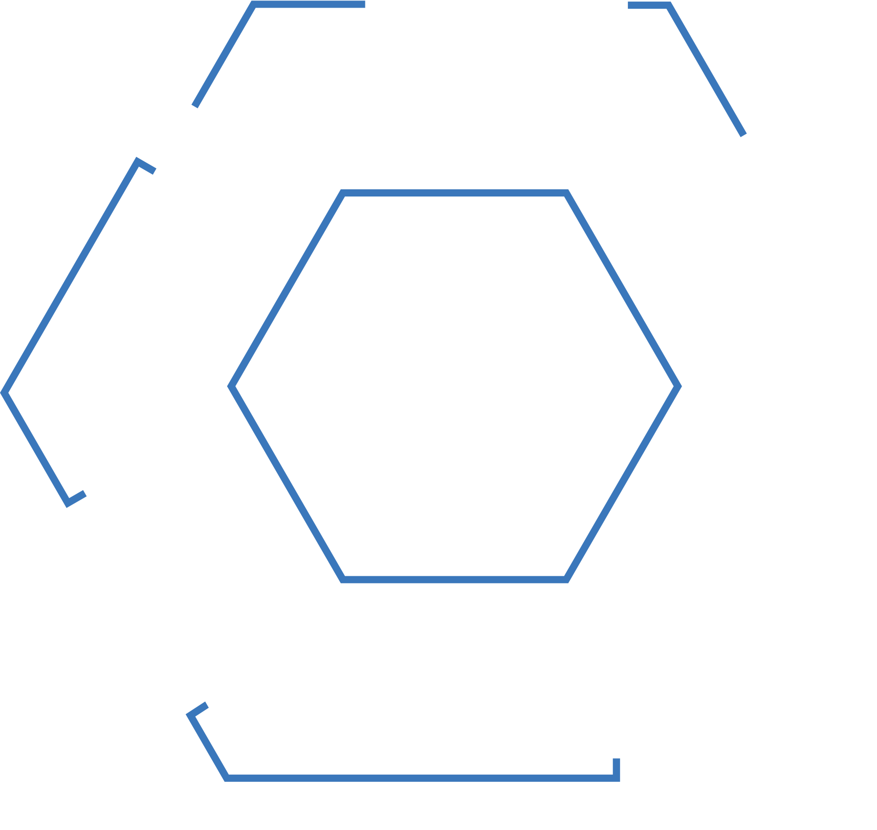

How to prevent?
For added security, implement multi-factor authentication (MFA) on all accounts. This adds an extra layer of protection even if a password is stolen. Educate yourself and others about recognizing red flags like urgent requests or offers that seem too good to be true.
Avoid sharing personal information on public platforms, and limit what is accessible about you online. When using public Wi-Fi, always use a VPN to protect your data. Ensure all your devices and applications are updated to the latest versions, as updates often fix security vulnerabilities.

Slide 10

How to prevent?
Enable approval workflows for sensitive actions, like financial transactions, to ensure multiple layers of verification. Trust your instincts—if something feels off, take a moment to pause and verify through official channels. These simple yet effective habits can significantly reduce the risk of falling victim to phishing.
Always verify emails, texts, or calls that request sensitive information. Check the sender's address and hover over links before clicking to see their actual destination. Use spam filters and antivirus software to block suspicious messages and files.

